Slide 1

Windows Powershell
Powershell in Automation

Slide 2
Introduction
windows powershell is a Command line language which basically reuses .net framework.
When it comes to windows oS,its totally built out of .net
Powershell has tight integration with different platforms can be used in Cloud azure,aws windows machines,Vmware,SCCM,AD etc.
Mostly used by systemadmin to automate routine daily tasks,like generating reports for CPU memrory,getting service status,installing applications,getting server uptime,migrations etc
Latest version:
v5.1(part of windows management framework 5.1)
Powershell 7(Powershell –core,Cross-platform)
Interactive Mode and Scripting Mode(ISE)
7. Which is object based approach and operates on .net,WMI,COM Objects

Slide 3
Powershell Host
1. Console Host
2. ISE Host
$Host
$psversiontable.PSVersion.Major

Slide 4
Execution Policy
The execution policy is part of the security strategy of Windows PowerShell.
Restricted - No scripts can be run. Windows PowerShell can be used only in interactive mode.
AllSigned - Requires that all scripts and configuration files be signed by a trusted publisher, including scripts that you write on the local computer.
RemoteSigned - Scripts which are required to run remotely needs digital signature but for the scripts which runs on local machine not required
Unrestricted - No restrictions; all Windows PowerShell scripts can be run.
Bypass : Nothing is blocked and there are no warnings or prompts ,so its just by pass execution
Default : Sets default policy as Restricted for Windows clients., RemoteSigned for Windows servers.

Slide 5
Variables and Datatypes
Variables are data holding elements and data can be anything like string,object,which is to store information.
Different languages has different rules
Example : $hello
Some properties :
Which starts with $
Directly values can be assigned without defining it
Variable names are not case sensitive
Ex: $hello=“test” or $HELLO=“test”
Variables are combination of numbers and characters
Ex: $xyz123=123345

Slide 6
Variables and types
Variables
User varibles
System or environment variables
Preference Variables
Readonly Variables
Constant variables

Slide 7
Variables cont….
Varibles types :
Uservaribles or User created Varibles :
which is created and maintained by user.which is limited to particular window.once windows is closed variables are disappeared.
How to set user variables for reusing purpose using Profile ? Or in script local or global scope
example:
open powershell -> Run as administrator
PS C:\Windows\system32> $pshome #powershell default homepath
C:\Windows\System32\WindowsPowerShell\v1.0
PS C:\Windows\system32> cd C:\Windows\System32\WindowsPowerShell\v1.0 #change directory to home path
PS C:\Windows\System32\WindowsPowerShell\v1.0> New-Item -Path "profile.ps1" -ItemType File(#creates new file called “profile.ps1)
PS C:\Windows\System32\WindowsPowerShell\v1.0> notepad.exe .\profile.ps1(open profile file in notepad)
PS C:\Windows\System32\WindowsPowerShell\v1.0> Get-Content .\profile.ps1(display output)
$var="hello world"

Slide 8
Variables contd…
System variables : which is also called environment varaibles set by the operating system and store oS info,which can not be changed regularly.
Ex: $env: PSEXecutionPolicyPreference
$env:PSMOdulePath
$pshome
$home
$host
Preference variables :
Which is used to change the preference of current execution script or powershell window.
Example :
$MaximumHistoryCount
$Confirmpreference
$Informationpreference
$warningpreference

Slide 9
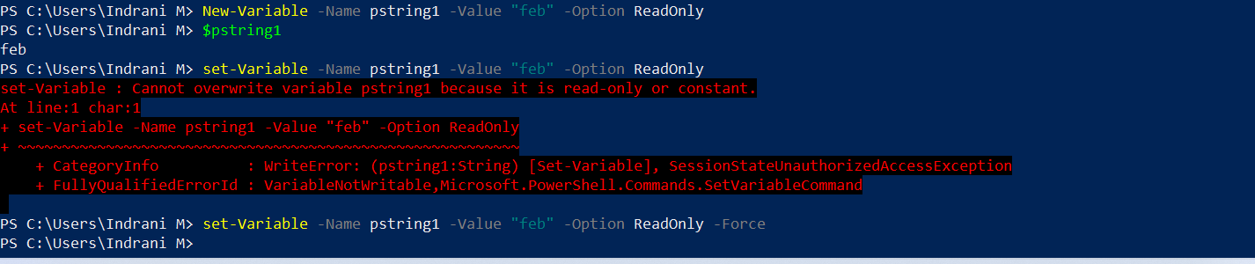
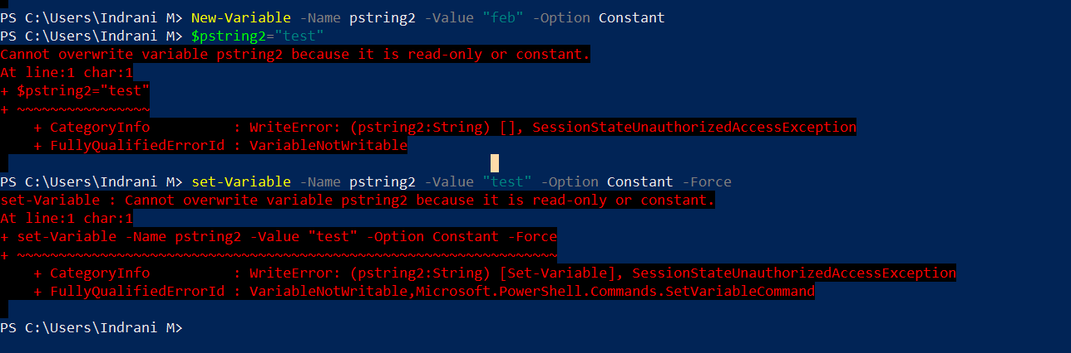
Variables contd..
What is the difference between a read-only variable and a constant?
A read-only variable is one with content that is read-only. It can, however, be modified by using the Set-Variable cmdlet with the –force parameter. It can also be deleted by using Remove-Variable –force.
A constant variable, however, cannot be deleted, nor can it be modified–even when using the force.

Slide 10
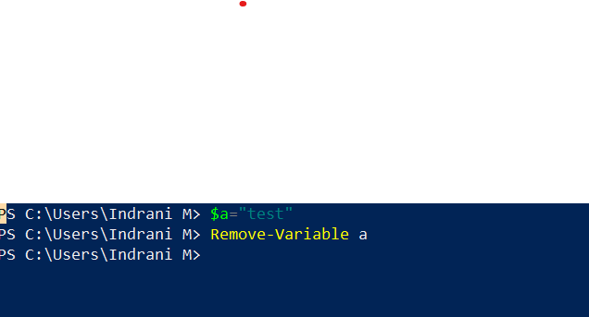
How to delete variables ?
Single and double quotes ?
Variables inside double quotes (") are interpreted unless they are commented out with `
Variables inside single quotes (') are not interpreted.
Input of variables by the user
[int]$x=read-host -prompt "please enter a number“

Slide 11
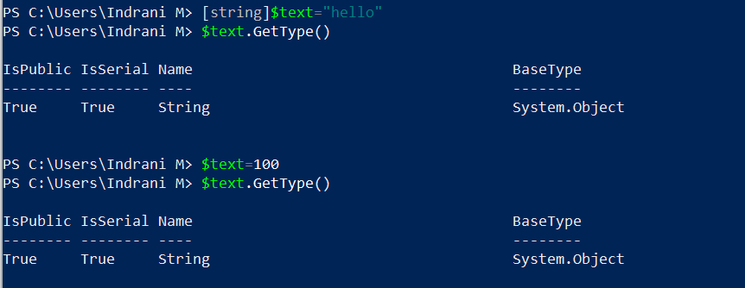
Datatypes : Datatype is kind of data used for variables How to get type ? $hello=“good morning” $hello.GetType()
Dynamic data type
Datatype can be automatically changes depending on data that is stored in variable
$message=“hello world”
$message.GetType()
o/p: string
$messge=100
$message.GetType()
o/p : Integer
Scenario :when you are working on dynamic data
from systems
Static data type:
Datatype can be fixed and can not be changed
Example:[string]$text=“hello”
$text.GetType()
$text=100
$text.getType() = still string, so explicitly can not be changed

Slide 12
Types of data in powershell
1. special types
a. The void type
b.The $null type -null type [null]
c. The Object Type
2. Value Types
a. Boolean - [bool] (yes or no)
b. Character -[char](defines single character)
c. Integer –(numeric values)
d. Real numbers like float and double – 13.2 or 13.22
e. decimal (13.33333333)
Float represent data with single precision. Double represent data with double precision. Decimal has higher precision than float and Double

Slide 13
Types contd..
Reference types
1. Strings –collection of characters
$a= “test”
2. Arrays- An array is a data structure that is designed to store a collection of items. The items can be the same type or different types
$a=(“test”,123,”test2)
a[0],a[1]
3. Hashtables : s a compact data structure that stores one or more key/value pairs.
$h1 = @{ FirstName = "James"; LastName = "Anderson"; IDNum = 123 }
$h1.FirstName # designates the key FirstName
$h1["LastName"] # designates the associated value for key LastName
$h1.Keys # gets the collection of keys
4. The XML type :The XML data type is used for Extensible Markup Language (XML) documents
5.The Regex type
6.scriptblock

Slide 14
Operators
Arithmetic Binary Operators
+, -, *, \, %, ++, --
Assignment Operators
=, +=, -=, *=, /=, %=
Logical Operators
!, -not, -and, -or
String Operators
+, *, -f, -replace, -match, -like
Comparison Operators
-eq, -ne, -gt, –ge, -lt, –le

Slide 15
Arithmetic operators contd.. $A holds 30 and $b holds 20
Operator | Description | Example
+ (Addition) | This operator is used for adding values on either side of the operator. | A + B will give 40
- (Subtraction) | This operator is used for subtracting right-hand operand from the left-hand operand. | A - B will give -20
* (Multiplication) | This operator is used for multiplying values on either side of the operator. | A * B will give 300
/ (Division) | This operator is used for dividing left-hand operand by right-hand operand. | B / A will give 3
% (Modulus) | This operator is used for dividing left-hand operand by right-hand operand and returns the remainder. | B % A will give 0
++ | Increment the value by 1 | $a++ or $a=$a+1
-- | Decrement the value by 1 | $a-- or $a=$a-1

Slide 16
Real time example
Addition : +
Adds numbers, concatenates strings, arrays, and hash tables
6 + 2 # result = 8
"file" + "name" # result = "filename"
@(1, "one") + @(2.0, "two") # result = @(1, "one", 2.0, "two")
@{"one" = 1} + @{"two" = 2} # result = @{"one" = 1; "two" = 2}
(Get-Date).AddDays(-1)
Substration: -
$a=10
$b=3
(Get-Date).AddDays(-1) # Yesterday's date
$c=$a-$b

Slide 17
examples
multiply
6 * 2 # result = 12 @("!") * 4 # result = @("!","!","!","!") "!" * 3 # result = "!!!"
Division : /
$a=10
$b=25
$a\$b=
Modular division : %
Gives the remainder

Slide 18
examples
++ and --
++ : increase the value by one,
$c=1
$c++: if I run this multiple times,the number get increased
$c++ equals to $c=$c+1
Which is actually happening is increment
--
$c=$c-1
I am substarcting 1 from $c and assigining back to $c
Simple ++ incremnets by 1 and – decrements by 1

Slide 19
Assignment operators $x=30,$y=20
Operator | Description | Example
= | Assign value to variable | $z=$x+$y,o/p $x=50
- = | Subtract the right hand side value and assign | $z -= 30(it substarct 30 from $z and assigns the value to $z)
+ = | Which is add the right hand side value and assign | $z +=30(it add 30 to $z and assign the value
*= | Multiply and assign | $z *= 10
%= | Modular divison and assign | $z %=30

Slide 20
Realtime examples
Example 1: Output of any powershellcommands
$a= get-process
$a=ipconfig
$a=get-service
$a=hostname
$email="devopstraining@gmail.com"
Example 2: send an email notification failure or success to teams.
$emailbody =“this is my Ipaddress”
$emailbody +=“my hostname is $a ”
$emailbody += “sending an email to $email”
Example 3: To store multiple commands output to one variable
$a=hostname
$a +=get-service

Slide 21
Comparison operators
Type | Operator | Description
Equality | -eq | Compares two values to be equal or not. $y=10 $y –eq 10 o/p :true
not equals | -ne | Compare the two values to be not equal. $y –ne 10 o/p : false
greater than | -gt | Compares the first value to be greater than the second one. $x=10,$y=20 $x –gt $y o/p : false
greater than or equal | -ge | Compare the first value to be greater than or equals to the second one. $x –ge $y o/p :false
less than | -lt | Compare the first value to be less than the second one. $x –lt $y o/p :True
Less than or equal | -le | Compares first value to be less than or equals to second one. $x –le $y o/p : true

Slide 22
Assignment operators contd Examples
Check “windows search “service exists ?
$checkserviece=get-service | Where-Object {$_.name -eq "wsearch"}
Check user exists from active directory ?
$checkuser =Get-ADUser -Filter "Name -eq 'ChewDavid’”
Get files which are created two days back in particular folder
Get-ChildItem –path “c:users\test” |Where-Object{$_.CreationTime -le (get-date).AddDays(-2)}
Get files which are not created to today
Get-ChildItem –path “c:users\test” |Where-Object{$_.CreationTime -ne (get-date)}

Slide 23
Logical Operators
Type | operator | description
Logical not | ! : For reversing the output | $y =10 !($y –gt 5)
Logical and | -and :if all the statements true,it gives true. Which is to combine multiple statements | $y=10 ($y –gt 5) –and ($y –lt 4) –and($y –lt 6) o/p :true
Logical or | -or :If any of the statement is true, result is true | ($y –gt 5) –or ($y –lt 4) –or($y –lt 6)
Logical not | Similar to ! | -not($a+$b)

Slide 24
String operators
operator | description | example
-join | Which is used to join two strings | $a="hello" $b="goodmorning" $a -join $b
-like , -notlike,clike,ilike | Like operator returns true value when string matches the wildcard(*) | "PowerShell" -like "*shell“ o/p :true
-contains | This operator tells,if set of values includes a single value | “Windows”,”linux” –contains “linux” 1,10 –notcontains 5
-match | This operator will return a true value when the string matches the regex pattern | indu@training.com –match “^[a-zA-Z0-9+_.-]+@[a-zA-Z0-9+_.-]+$” $Ippattern =“^(?:[0-9]{1,3}\.){3}[0-9]{1,3}$ 128.10.6.9 –match $ipatterm
-replace | Which we will replace the values in a varaibles | $messge= “hello indu” $message –replace “indu” ,“hani”
Is ,isnot | Type comparision operators

Slide 25
cmdlets
Smallest piece of code is called cmdlet
Write-host “write msg to console”
There are many cmdlets,go through basic few cmdlets
One of the most important topic
Standard practice is –
Write-host “write msg to console”
Cmdlets are verb-noun format
verb-noun -parameter “test” –parameter 100 –switch
Copy-Item (copy perform it on )
Start-sleep (start pertform on sleep)
Test-path
Test-connection
Get-content
Export-csv

Slide 26
Cmdlet contd—
Get-help
Which gives all information about particular command
Get-help write-host
Explanation of write-host syntax
SYNTAX
Write-Host [[-Object] <Object>] [-NoNewline] [-Separator <Object>] [-ForegroundColor {Black | DarkBlue | DarkGreen
| DarkCyan | DarkRed | DarkMagenta | DarkYellow | Gray | DarkGray | Blue | Green | Cyan | Red | Magenta | Yellow |
White}] [-BackgroundColor {Black | DarkBlue | DarkGreen | DarkCyan | DarkRed | DarkMagenta | DarkYellow | Gray |
DarkGray | Blue | Green | Cyan | Red | Magenta | Yellow | White}] [<CommonParameters>]

Slide 27
Cmdlets contd..
-object (any data type)
-separater : any spearaters like |,, etc
-forground
-backgroundś
-nonewline : all stamenst in single line
Imp :Powershell documentation can also be used
Get-help Get-content
Parameters :. A parameter is a way that developers enable script users to provide input at runtime. Or passing arguments
Property : charcterstic of an item

Slide 28
Imp: force and wait are switch typeso\p will be differed and types depends on it will read whater is there in file parameters
Get-Content
[-Path] <string[]>
[-ReadCount <long>]
[-TotalCount <long>]
[-Tail <int>]
[-Filter <string>]
[-Include<string[]>]
[-Exclude <string[]>]
[-Force]
Credential <pscredential>]
[-UseTransaction]
[-Delimiter <string>]
[-Wait]
[-Raw]
[-Encoding {Unknown | String | Unicode | Byte | BigEndianUnicode | UTF8 | UTF7 | UTF32 | Ascii |
Default | Oem | BigEndianUTF32}]
[-Stream <string>] [<CommonParameters>]

Slide 29
Common parameters
Parameters which are common to all cmdlets
Like
-force.
Wait
Crdentails etc

Slide 30
